Slide 1
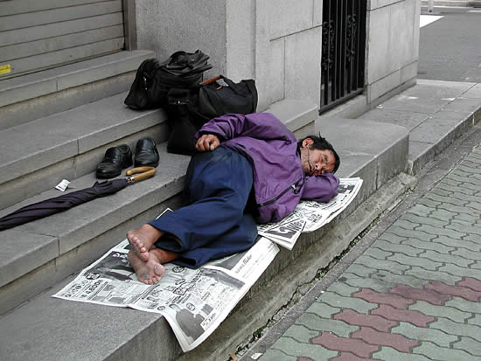
Homeless
People

Slide 2
What is Homeless Help
Homeless Help is a charity devoted to help homeless people.

Slide 3
Why people leave home
Some people leave because they are unhappy
Also some get abused
Or because people threaten then to leave home
Or they are unhappy with there parents
There parents may even have a argument with them

Slide 4
Do you want to help?
Think of this:
If you give us a donation you could help someone to get a life.
Would you like to be responsible for someone dieing because you didn’t give us a donation?

Slide 5
Our website
If you want to see our website:
www.homeleshelp.webs.com
Videos of homeless people

Slide 6


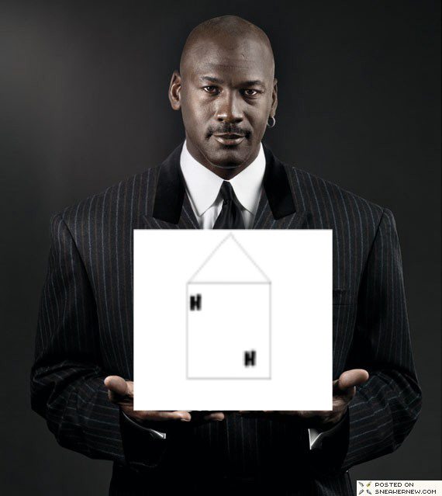

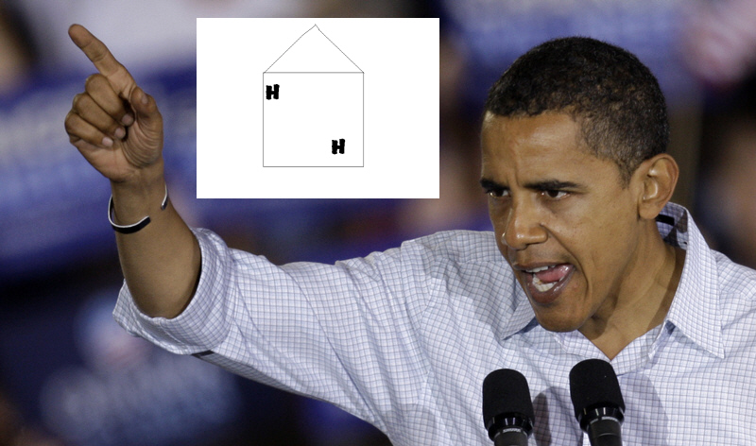
People Who are helping us

